Slide 1
CISC 181
March 23, 2021
University of Delaware
By James Villemarette

Slide 2
PowerPoint Overview
some quick things
Problems I’ve noticed with lab 2
Style
Special problems with lab 2 & 3
Future stuff to know
Looking ahead to lab 4
What to know for this week

Slide 3
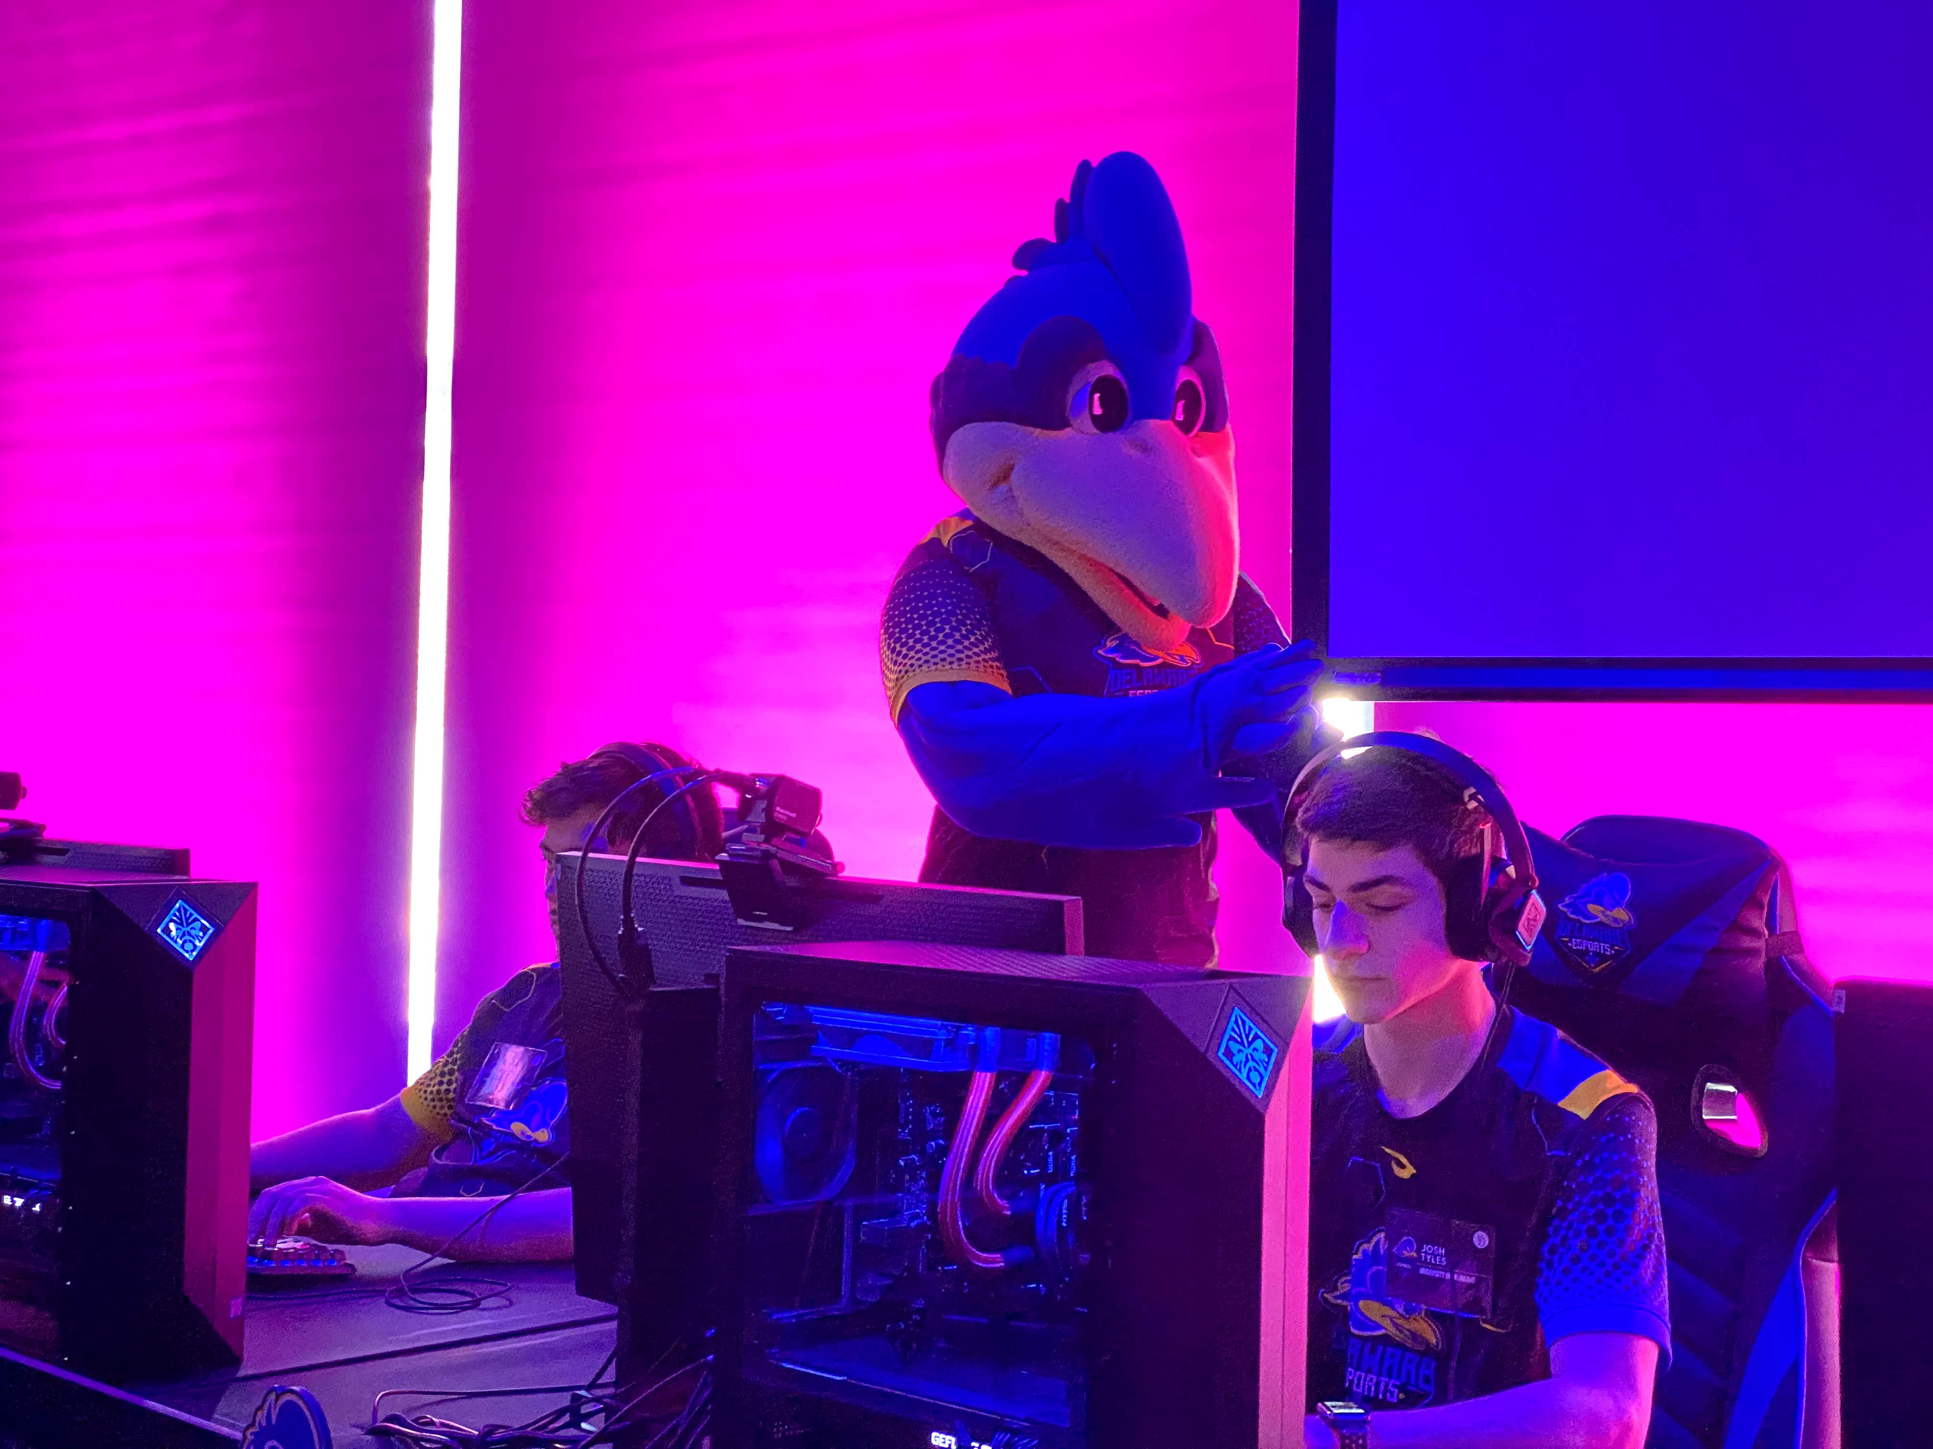
some quick things

Slide 4
Access Modifiers (Disclaimer)
This PowerPoint, like the previous ones, will use the (default) access modifier in most places
(default) means no access modifier is listed
NOT like private int countStuff;
But like int countStuff;
This is done to make this PowerPoint more readable
You should almost always list an access modifier

Slide 5





Re-coop Day Next Week
March 30: Blue Hen Re-coop Day
No classes, no lab!

Slide 6
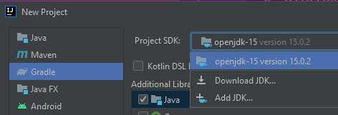
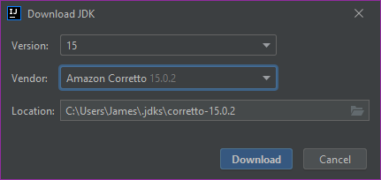
JDK 16
JDK 16 is now out
Don’t use it
New JDK’s are almost always buggy
Can introduce unexpected new problems or rules
Amazon distro seems to be fine

Slide 7
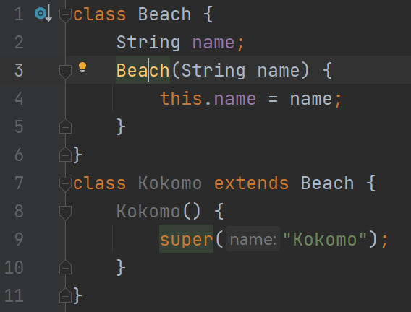
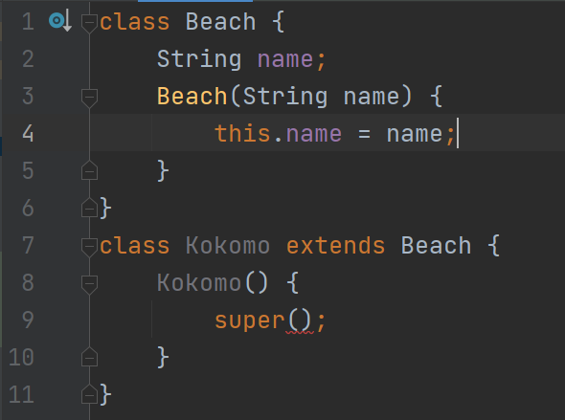
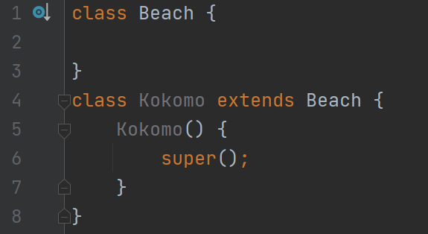
super() & no-arg constructor
Java implicitly gives a class a no-argument constructor
But when you define a constructor, that^ is gone
You can use super.name, but that’s bad form
Best to rely on other code
Beach() { }

Slide 8
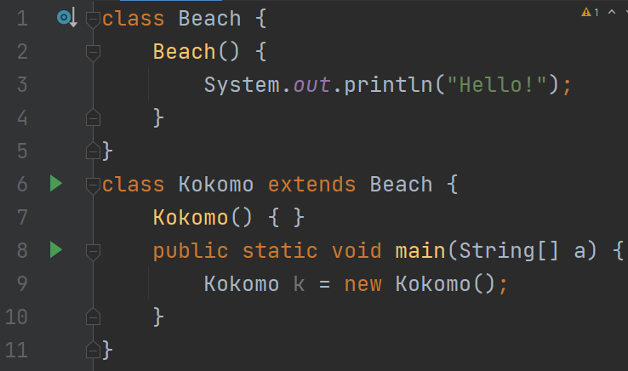
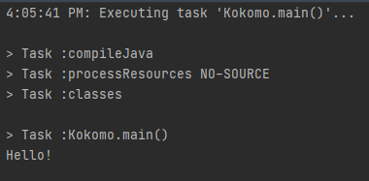
super() & no-arg constructor
Super is always called!
Beware

Slide 9
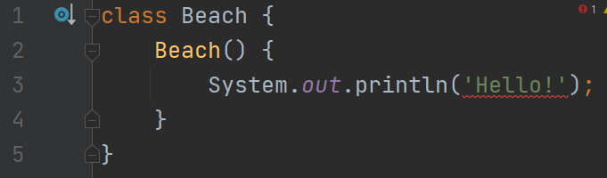
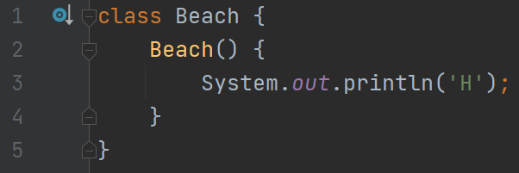
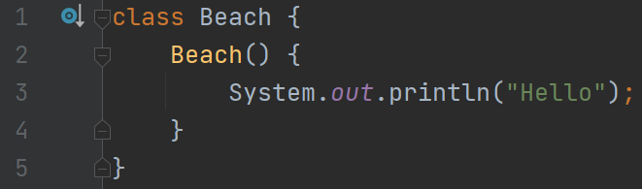
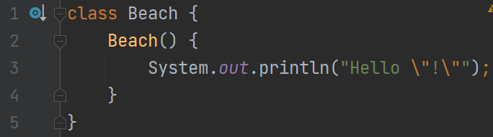
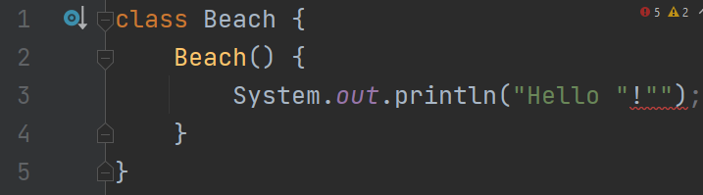
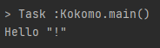
Escape Characters
#1
Again: Every { must have a corresponding }
Same thing for ( and )
Same thing for “ and “
Strings are only contained in “ and “ (double quotes)
Python allows “ and “, or ‘ and ‘ (single quotes)
In Java, ‘ and ‘ means a character literal
#2
#3
#5
#4

Slide 10


Run your Unit Tests!
About half of the unit tests that were submitted failed
Always include the unit tests the instructions give you
Add your own, even if the instructions don’t explicitly require it
Unit tests are a pain, but they’re important

Slide 11

Unit Test All The Things
Java is like Mathematics. You can check yourself
You need to test getters and setters
Accessors and mutators
But that sounds dumb!
Yes, it kind of does, but it helps make sure you’re not making avoidable mistakes

Slide 12

style

Slide 13
Class Organization
Let’s cover this super quickly
How do we organize classes?
This is just a convention
Every project/group/team/company will have different standards
But generally
class MyCoolClass {
class variables
private int attack;
constructor(s)
public MyCoolClass(…) {…}
method(s)
public int getAttack() {…}
}

Slide 14

JavaDoc (part deux)
“A plane isn’t ready to fly until it’s weight in documentation has been generated.”
Quote by someone
“Documentation is a love letter that you write to your future self.”
Quote by Damian Conway

Slide 15
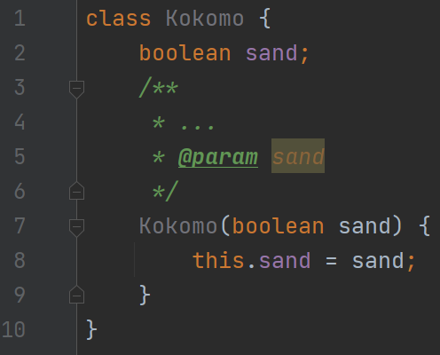
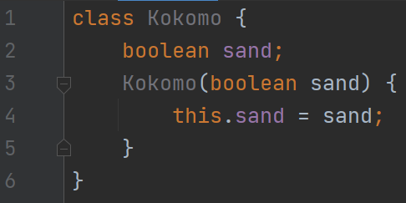
JavaDoc (part deux)
You need it.
Proper documentation is like water.
Threshold for good doc?
“I know it when I see it” by US Supreme Court Justice Stewart
Is this good?
How about this one >>
0/5
0/5

Slide 16
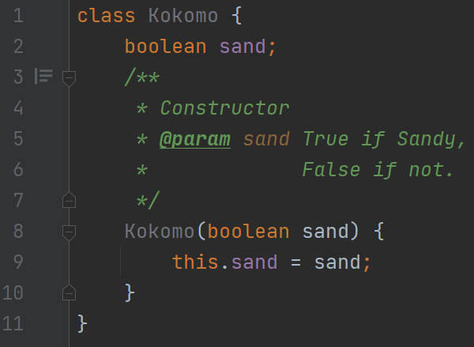
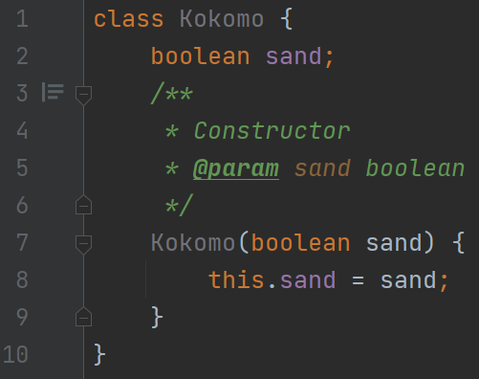
JavaDoc (part deux)
Or this one?
And this one?
4/5
1/5
Redundant

Slide 17
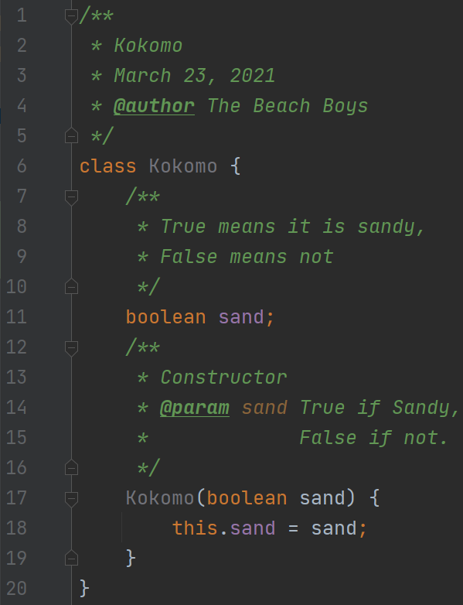
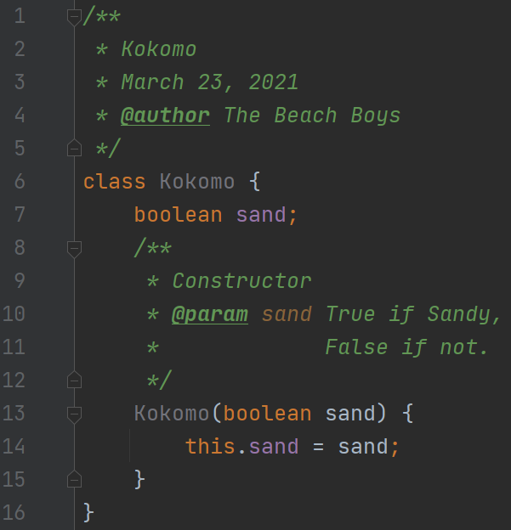
JavaDoc (part deux)
5/5!
Second to last one here <<<
5/5
Last one >>>

Slide 18
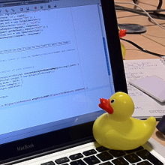
moveNegatives() in lab 3
Stage 1: Copy the negatives
Stage 2: Copy the positives
int[] values
Many students had trouble with this problem
Certainly, a more meta problem
Rubber duck Debugging
-
3
0
2
1
-
4
-
5
int[] newValues
-
3
-
4
-
Explaining your code to some-body/thing helps you realize specific problems
5
0
2
1
Note: The official code solution is not shared here. You should try doing this again if your lab solution did not work.
By Tom Morris on Wikipedia

Slide 19
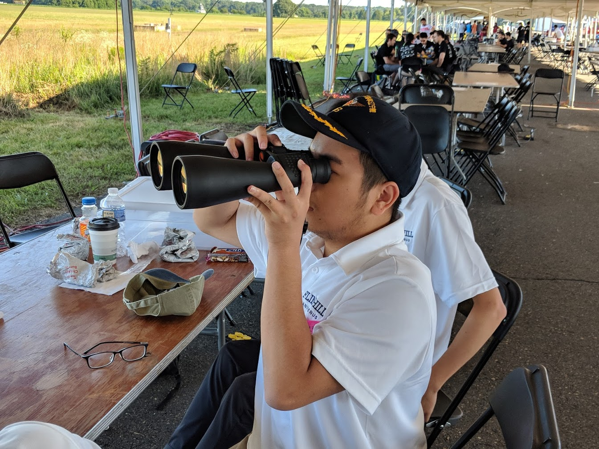
Looking ahead to lab 4

Slide 20
New Stuff (overview)
Abstract Classes
Overriding Methods, Polymorphism
public String toString()
Two-Dimensional Arrays

Slide 21
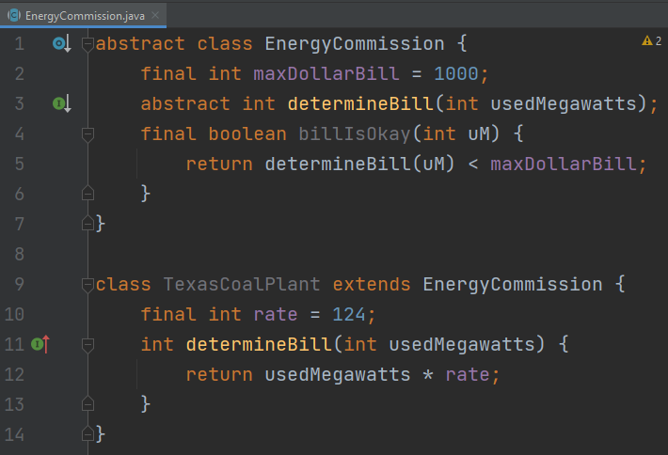
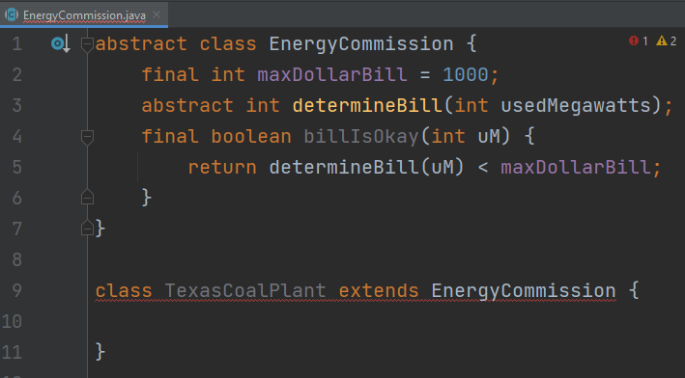
Abstract Classes
Used to avoid independence
Can declare methods that NEED to be implemented
Can implement methods itself

Slide 22
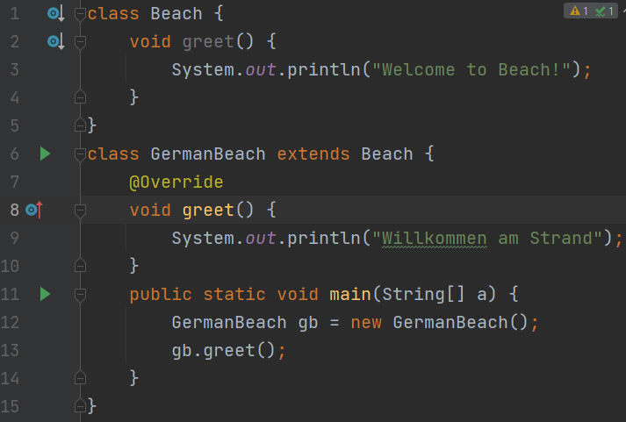
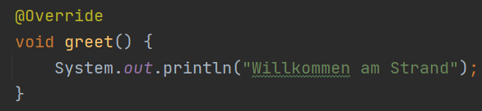
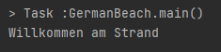
Overriding Methods, Polymorphism
Polymorphism: A term more complicated that what it’s describing
Industry “buzz word” that WILL appear in a dev. interview
Comes in two flavors
Overriding
Overloading
@Override annotation
It’s technically optional
Practically, it’s NOT optional

Slide 23
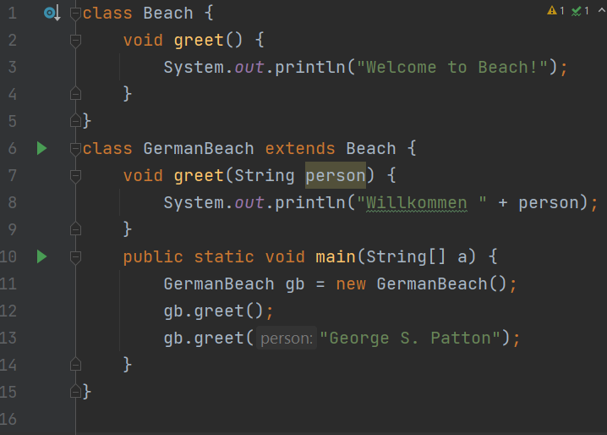
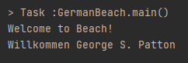
Overriding Methods, Polymorphism
Overloading: For making a method with the same name perform two different behaviors
What makes methods different?
Return type
Type of the parameter(s)
Does NOT use the @Override annotation
Why do we overload?
We always want to make our code as simple as possible. Using the same name for two methods is one way

Slide 24
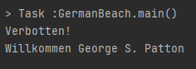
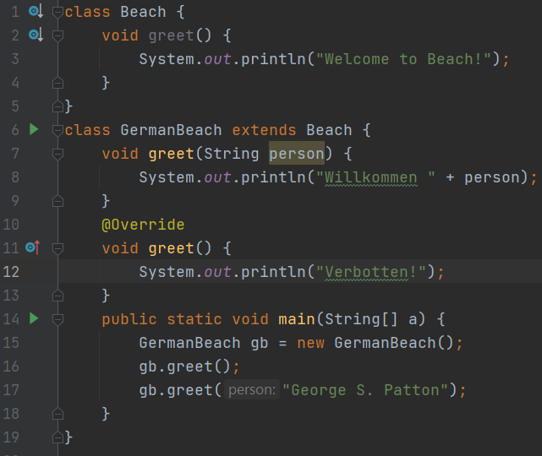
Overriding Methods, Polymorphism
Examine the case below
What does it print?
Original
Updated
New method

Slide 25
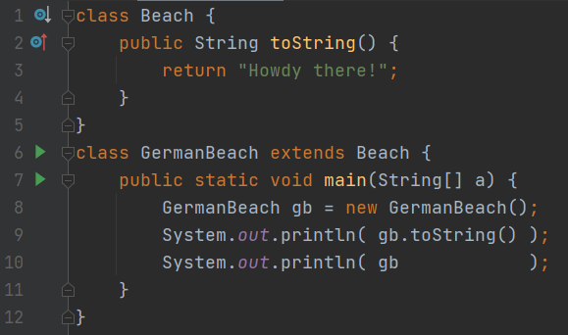
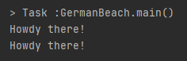
public String toString()
A common case of Overriding
Is a unique/non-unique String representation of an object
System.out.println will implicitly call it
MUST RETURN A STRING
Do NOT print

Slide 26

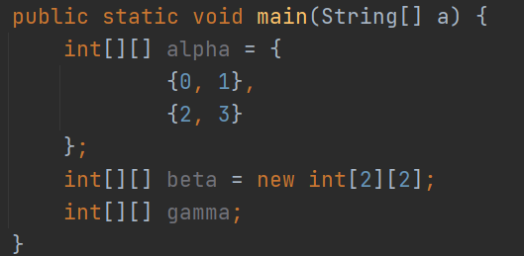
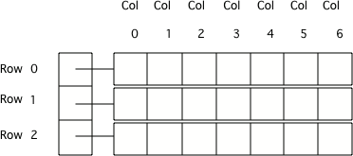
Two-Dimensional Array
A regular array, but more
Yep, that’s it, yup, mmhmmm
The same three flavors
Row-major ordering
The ROW comes first, then the COLUMN
Although, Java is technically neither
int[][] is just an int[] which has references to arrays of int
<< How do you get this?
alpha[0][1]
alpha[row][col]

Slide 27

that’s all :)

